Slide 1
Analysis Process Example
Grateful acknowledgement to Dr. Paul Tael for some of the material used here

Slide 2
Problem Description

Slide 3
Problem Description
Given a whole number that is not negative, calculate the sum of its digits.

Slide 4
Problem Description, Example
Given a number:
13,579
Calculate sum of digits:
1 + 3 + 5 + 7 + 9 = 25

Slide 5
Analysis: Initial Details

Slide 6
Problem Description, Revisited
Problem Description
Problem Breakdown
Given a whole number that is not negative, calculate the sum of its digits.
Input:
A whole number that is not negative.
Output:
The sum of digits of the non-negative whole number.

Slide 7
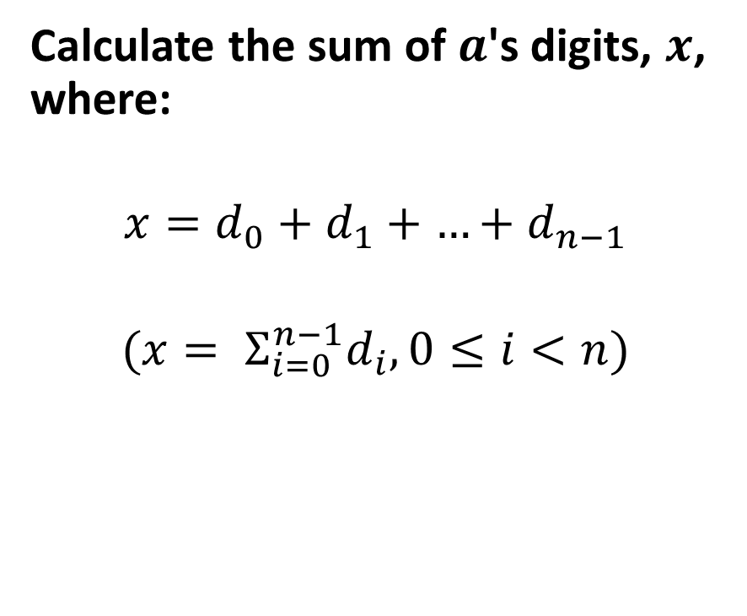

Problem Description, Domain
Given some non-negative number $a$ and digit $d_{i}, 0≤i<n,$ where:
$$a={|d}_{0}\left|d_{1}\right|{…|d}_{n−1}|$$
Calculate the sum of $a$'s digits, $x$, where:
$$x=d_{0}+d_{1}+{…+d}_{n−1}$$
$$(x= Σ_{i=0}^{n−1}d_{i}, 0≤i<n)$$

Slide 8
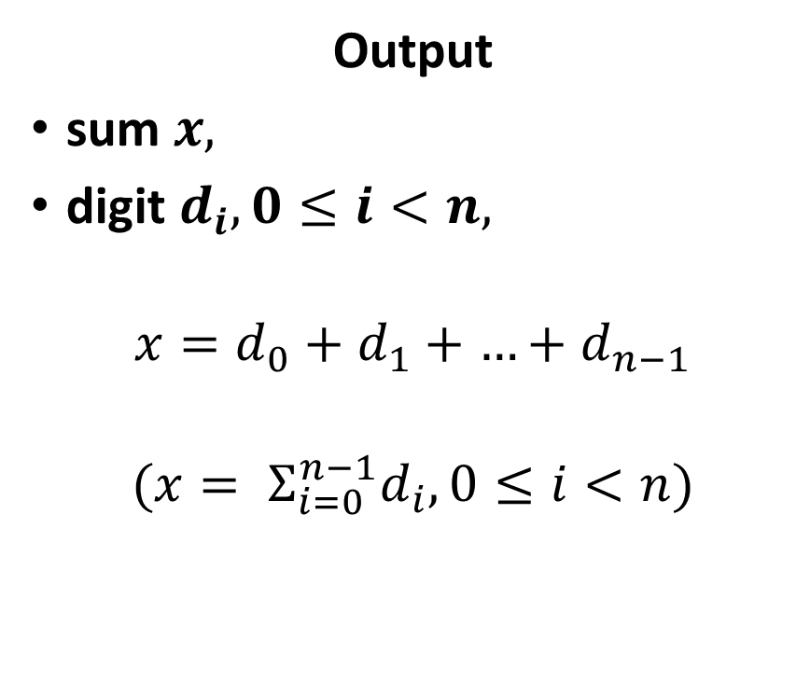

Problem Description, Requirements
Input
number $a,$
digit $d_{i}, 0≤i<n,$
$$a={|d}_{0}\left|d_{1}\right|{…|d}_{n−1}|$$
Output
sum $x,$
digit $d_{i}, 0≤i<n,$
$$x=d_{0}+d_{1}+{…+d}_{n−1}$$
$$(x= Σ_{i=0}^{n−1}d_{i}, 0≤i<n)$$

Slide 9
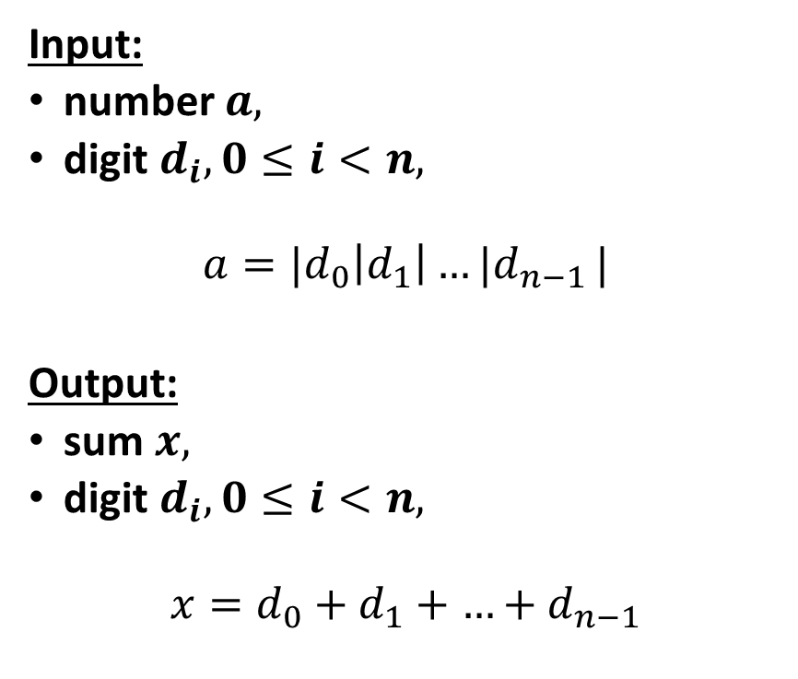
Problem Description, Considerations
Question:
What different ways can you solve this problem by hand?
Input:
number $a,$
digit $d_{i}, 0≤i<n,$
$$a={|d}_{0}\left|d_{1}\right|{…|d}_{n−1}|$$
Output:
sum $x,$
digit $d_{i}, 0≤i<n,$
$$x=d_{0}+d_{1}+{…+d}_{n−1}$$

Slide 10
Analysis: First Attempt (String Conversion)

Slide 11
Analysis: First Attempt (String Conversion)
Example Approach:
Take a number: 13,579
Store as int: 13579
Convert into string: "13579"
Process each character in string.

Slide 12
Analysis: First Attempt (String Conversion)
Generalized Pseudocode:
Step 1. Assign value to input.
E.g., cin, ifstream
Step 2. Convert int to string.
std::to_string(int)
Step 3. Loop through each char in string.
string::at(int)
string::length()
Step 3A. Convert char digit to int digit.
char – 48 → int
Step 3B. Update sum with int digit.
+=

Slide 13
Analysis: First Attempt (String Conversion)
number
sum
13579
0
Generalized Pseudocode:
Step 1. Assign value to input.
E.g., cin, ifstream
cin,
ifstream

Slide 14
Analysis: First Attempt (String Conversion)
number
sum
13579
0
Generalized Pseudocode:
Step 1. Assign value to input.
E.g., cin, ifstream
Step 2. Convert int to string.
std::to_string(int)
text
'1'
'3'
'5'
'7'
'9'
data
5
length

Slide 15
Analysis: First Attempt (String Conversion)
number
sum
13579
0
Generalized Pseudocode:
Step 1. Assign value to input.
E.g., cin, ifstream
Step 2. Convert int to string.
std::to_string(int)
Step 3. Loop through each char in string.
string::at(int)
string::length()
0
digit
text
'1'
'3'
'5'
'7'
'9'
data
5
length

Slide 16
Analysis: First Attempt (String Conversion)
number
sum
13579
0
Generalized Pseudocode:
Step 1. Assign value to input.
E.g., cin, ifstream
Step 2. Convert int to string.
std::to_string(int)
Step 3. Loop through each char in string.
string::at(int)
string::length()
Step 3A. Convert char digit to int digit.
char – 48 → int
1
digit
text
'1'
'3'
'5'
'7'
'9'
data
5
length

Slide 17
Analysis: First Attempt (String Conversion)
number
sum
13579
1
Generalized Pseudocode:
Step 1. Assign value to input.
E.g., cin, ifstream
Step 2. Convert int to string.
std::to_string(int)
Step 3. Loop through each char in string.
string::at(int)
string::length()
Step 3A. Convert char digit to int digit.
char – 48 → int
Step 3B. Update sum with int digit.
+=
1
digit
text
'1'
'3'
'5'
'7'
'9'
data
5
length

Slide 18
Analysis: First Attempt (String Conversion)
number
sum
13579
16
Generalized Pseudocode:
Step 1. Assign value to input.
E.g., cin, ifstream
Step 2. Convert int to string.
std::to_string(int)
Step 3. Loop through each char in string.
string::at(int)
string::length()
Step 3A. Convert char digit to int digit.
char – 48 → int
9
digit
text
'1'
'3'
'5'
'7'
'9'
data
5
length

Slide 19
Analysis: First Attempt (String Conversion)
number
sum
13579
25
Generalized Pseudocode:
Step 1. Assign value to input.
E.g., cin, ifstream
Step 2. Convert int to string.
std::to_string(int)
Step 3. Loop through each char in string.
string::at(int)
string::length()
Step 3A. Convert char digit to int digit.
char – 48 → int
Step 3B. Update sum with int digit.
+=
9
digit
text
'1'
'3'
'5'
'7'
'9'
data
5
length

Slide 20
Analysis: First Attempt (String Conversion)
Question:
Of the following steps, which one of these causes inefficiency in the generalized pseudocode?
Generalized Pseudocode:
Step 1. Assign value to input.
E.g., cin, ifstream
Step 2. Convert int to string.
std::to_string(int)
Step 3. Loop through each char in string.
string::at(int)
string::length()
Step 3A. Convert char digit to int digit.
char – 48 → int
Step 3B. Update sum with int digit.
+=

Slide 21
Analysis: First Attempt (String Conversion)
number
sum
13579
25
Time Complexity:
Need to copy the digits into a new data structure one-by-one.
Need to visit each digit in the string one-by-one.
Need to convert each char into an int.
Space Complexity:
Need to store separate data structure as a string object, consisting of the char sequence and other auxiliary data (e.g., length).
Need to create a separate data structure to store each digit as a char.
Need to store value to convert char to int.
9
digit
text
'1'
'3'
'5'
'7'
'9'
data
5
length

Slide 22
Analysis: Second Attempt (Left-to-Right Number Slicing)

Slide 23
Analysis: Second Attempt (Left-to-Right Number Slicing)
Objective: Re-interpret the number 13,579?
13,579
= (1 × 10,000) + (3 × 1,000) + (5 × 100) + (7 × 10) + (9 × 1)
= (1 × 10⁴) + (3 × 10³) + (5 × 10²) + (7 × 10¹) + (9 × 10⁰)

Slide 24
Analysis: Second Attempt (Left-to-Right Number Slicing)
(1 × 10⁴) + (3 × 10³) + (5 × 10²) + (7 × 10¹) + (9 × 10⁰)
Get left digit:
digit = 13579 / 10⁴ = 13579 / 10000 = 1
Update sum:
sum = 0 + 1 = 1
Remove left digit:
number = 13579 % (10⁴ × digit) = 13579 % (10000 × 1)
= 13579 % 10000 = 3579

Slide 25
Analysis: Second Attempt (Left-to-Right Number Slicing)
(1 × 10⁴) + (3 × 10³) + (5 × 10²) + (7 × 10¹) + (9 × 10⁰)
Get left digit:
digit = 3579 / 10³ = 3579 / 1000 = 3
Update sum:
sum = 1 + 3 = 4
Remove left digit:
number = 3579 % (10³ × digit) = 3579 % (1000 × 3)
= 3579 % 3000 = 579

Slide 26
Analysis: Second Attempt (Left-to-Right Number Slicing)
(1 × 10⁴) + (3 × 10³) + (5 × 10²) + (7 × 10¹) + (9 × 10⁰)
Get left digit:
digit = 579 / 10² = 579 / 100 = 5
Update sum:
sum = 4 + 5 = 9
Remove left digit:
number = 579 % (10² × digit) = 579 % (100 × 5)
= 579 % 500 = 79

Slide 27
Analysis: Second Attempt (Left-to-Right Number Slicing)
(1 × 10⁴) + (3 × 10³) + (5 × 10²) + (7 × 10¹) + (9 × 10⁰)
Get left digit:
digit = 79 / 10¹ = 79 / 10 = 7
Update sum:
sum = 9 + 7 = 16
Remove left digit:
number = 79 % (10¹ × digit) = 79 % (10 × 7)
= 79 % 70 = 9

Slide 28
Analysis: Second Attempt (Left-to-Right Number Slicing)
(1 × 10⁴) + (3 × 10³) + (5 × 10²) + (7 × 10¹) + (9 × 10⁰)
Get left digit:
digit = 9 / 10⁰ = 9 / 1 = 9
Update sum:
sum = 16 + 9 = 25
Remove left digit:
number = 9 % (10⁰ × 9) = 9 % (1 × 9)
= 9 % 9 = 0

Slide 29
Analysis: Second Attempt (Left-to-Right Number Slicing)
Example Approach:
Take a number: 13,579
Store as int: 13579
Get the left digit: 1
Add the left digit to the rolling sum using integer division: 0 → 1
Remove the left digit using modulo: 13579 → 3579
Repeat Steps 3 through 5 until all digits gotten.

Slide 30
Analysis: Second Attempt (Left-to-Right Number Slicing)
Question:
Which step is non-trivial to perform?
Example Approach:
Take a number: 13,579
Store as int: 13579
Get the left digit: 1
Add the left digit to the rolling sum using integer division: 0 → 1
Remove the left digit using modulo: 13579 → 3579
Repeat Steps 3 through 5 until all digits gotten.

Slide 31
Analysis: Second Attempt (Left-to-Right Number Slicing)
Details:
Getting the left digit is non-trivial.
13,579 = (1 × 10⁴) + (3 × 10³) + (5 × 10²) + (7 × 10¹) + (9 × 10⁰)
The current left digit for the above value is located in 10⁴.
But how do you get the 4 in 10⁴?
Example Approach:
Take a number: 13,579
Store as int: 13579
Get the left digit: 1
Add the left digit to the rolling sum using integer division: 0 → 1
Remove the left digit using modulo: 13579 → 3579
Repeat Steps 3 through 5 until all digits gotten.

Slide 32
Analysis: Second Attempt (Left-to-Right Number Slicing)
Naive Approach:
Assuming number is 13,579...
Get the left digit.
number < 10? → n = 0 for 10^{n}.
number < 100? → n = 1 for 10^{n}.
number < 1000? → n = 2 for 10^{n}.
number < 10000? → n = 3 for 10^{n}.
number < 100000? → n = 4 for 10^{n}.
number < 1000000? → n = 5 for 10^{n}.
And so on…

Slide 33
Analysis: Second Attempt (Left-to-Right Number Slicing)
Observations for More Optimal Approach:
Assume number is 13,579.
Divide number by 10 until number reaches 0.
Count how many times you divided by 10.
Count = 0: 13579 / 10 = 1357
Count = 1: 1357 / 10 = 135
Count = 2: 135 / 10 = 13
Count = 3: 13 / 10 = 1
Count = 4: 1 / 10 = 0
Count = 5 → 13579 has 5 digits

Slide 34
Analysis: Second Attempt (Left-to-Right Number Slicing)
Observations for More Optimal Approach:
13,579 has 5 digits.
13,579 = (1 × 10⁴) + (3 × 10³) + (5 × 10²) + (7 × 10¹) + (9 × 10⁰)
Let n = 5.
13,579 = (1 × 10^{n-1}) + (3 × 10^{n-2}) + (5 × 10^{n-3}) + (7 × 10^{n-4}) + (9 × 10^{n-5})
Let left digit be in the 10^{n-1} place.
→ n – 1 = 4
→ Left digit is in the 10⁴ place.

Slide 35
Analysis: Second Attempt (Left-to-Right Number Slicing)
More Optimal Approach:
Assuming number is 13,579...
Take a number: 13,579
Store as int: 13579
Get digit count of number: 5
Count how many times you can divide number by 10.
Get the left digit: 1
Divide 13579 by 10⁵⁻¹ = 10⁴.
Add left digit to the rolling sum using integer division: 0 → 1
Remove the left digit using modulo: 13579 → 3579.
Mod 13579 by the product of left digit 1 and left place 10⁴.
Repeat Steps 3 through 5 until all digits gotten.

Slide 36
Analysis: Second Attempt (Left-to-Right Number Slicing)
More Optimal Approach:
Assuming number is 13,579...
Take a number: 13,579
Store as int: 13579
Get digit count of number: 5
Count how many times you can divide number by 10.
Get the left digit: 1
Divide 13579 by 10⁵⁻¹ = 10⁴.
Add left digit to the rolling sum using integer division: 0 → 1
Remove the left digit using modulo: 13579 → 3579.
Mod 13579 by the product of left digit 1 and left place 10⁴.
Repeat Steps 3 through 5 until all digits gotten.
Question 1.
What is the naïve reason for slicing the number from left to right?
Sum of Digits for: 13,579
→ 1 + 3 + 5 + 7 + 9 = 25
Question 2.
Is there a benefit for slicing the number from left to right?

Slide 37
Analysis: Second Attempt (Right-to-Left Number Slicing)

Slide 38
Analysis: Second Attempt (Right-to-Left Number Slicing)
Assume the number be 13,579.
What happens when you get the modulo of a number by 10?
13579 % 10 = 9
You get the one's digit.
What happens when you divide a number by 10?
13579 / 10 = 1357
You remove the old one's digit.
You get a new one's digit.
When do you stop getting the one's digit?
13579 → 1357 → 135 → 13 → 1
1 / 10 = 0
Stop dividing when one's digit becomes 0.

Slide 39
Analysis: Second Attempt (Right-to-Left Number Slicing)
Details:
Approach does not rely on knowing how many digits is in the number.
I.e., keep looping until zero.
Simpler logic since no need to do another loop to count digits.
13579 = 9 + 7 + 5 + 3 + 1
Order is irrelevant since addition is commutative.
I.e., a + b = b + a
Example Approach:
Take a number: 13,579
Store as int: 13579
Get one's digit: 9
Number % 10
Add left digit to the rolling sum using integer division: 0 → 9
Remove the one's digit: 13579 → 1357
Number / 10
Repeat Steps 3 through 5 until one's digit is zero.

Slide 40
Analysis: Second Attempt (Right-to-Left Number Slicing)
13579 % 10 = 9
Sum: 0 → 9
Number: 13579 / 10 = 1357
1357 % 10 = 7
Sum: 9 → 16
Number: 1357 / 10 = 135
135 % 10 = 5
Sum: 16 → 21
Number: 135 / 10 = 13
13 % 10 = 3
Sum: 21 → 24
Number: 13 / 10 = 1
1 % 10 = 1
Sum: 24 → 25
Number: 1 / 10 = 0
Example Approach:
Take a number: 13,579
Store as int: 13579
Get one's digit: 9
Number % 10
Add left digit to the rolling sum using integer division: 0 → 9
Remove the one's digit: 13579 → 1357
Number / 10
Repeat Steps 3 through 5 until one's digit is zero.

